Slide 1
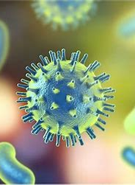
Response to infection
GTHBY Human Biology

Slide 2
Learning Intentions
Responses to infection including the inflammatory response

Slide 3
Success criteria
Define infection.
Describe signs and symptoms of infection.
List the 5 inflammatory responses.

Slide 4
What is an infection?
The invasion and multiplication of microorganisms such as bacteria, viruses, and parasites that are not normally present within the body. An infection may cause no symptoms and be subclinical, or it may cause symptoms and be clinically apparent.

Slide 5
Symptoms
Symptoms of bacterial infections vary depending on where in your body is infected. The main symptom is often fever, except skin infections, which usually cause redness or pain on your skin. Common symptoms of bacterial infections include:
Fever.
Chills.
Fatigue (tiredness).
Headache.

Slide 6
The Inflammatory Response
The inflammatory response (inflammation) occurs when tissues are injured by bacteria, trauma, toxins, heat, or any other cause. The damaged cells release chemicals including histamine, bradykinin, and prostaglandins. These chemicals cause blood vessels to leak fluid into the tissues, causing swelling.

Slide 7
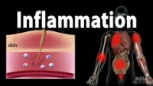

Slide 8

Inflammation
There are five signs of inflammation that include:
heat (calor),
redness (rubor),
swelling (tumor),
pain (dolor),
and loss of function (functio laesa).

Slide 9
Stages of inflammation
Acute inflammation can be discussed in terms of two stages;
(1) the vascular phase, followed by
(2) the cellular phase.

Slide 10
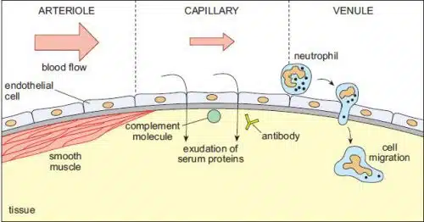

Slide 11
Success criteria
Define infection.
List the 5 inflammatory responses.
Describe signs and symptoms of infection.

